Slide 1
The W3C Linked Building Data Community Group
Chairs:
Kris McGlinn, Trinity College Dublin, Ireland
Georg Ferdinand Schneider, Schaeffler Technologies AG & Co. KG, Germany
Maxime Lefrançois, MINES Saint-Étienne, France
Mads Holten Rasmussen, NIRAS, Danemark
This presentation has contributions from several members of the community group

Slide 2
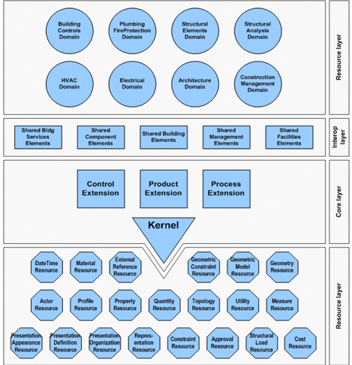
The CURENT PROBLEM: Industry Foundation Classes (IFC)
There exists a standard, but:
not modular
not extensible
not simple enough to use
AND not Web-compliant !

Slide 3
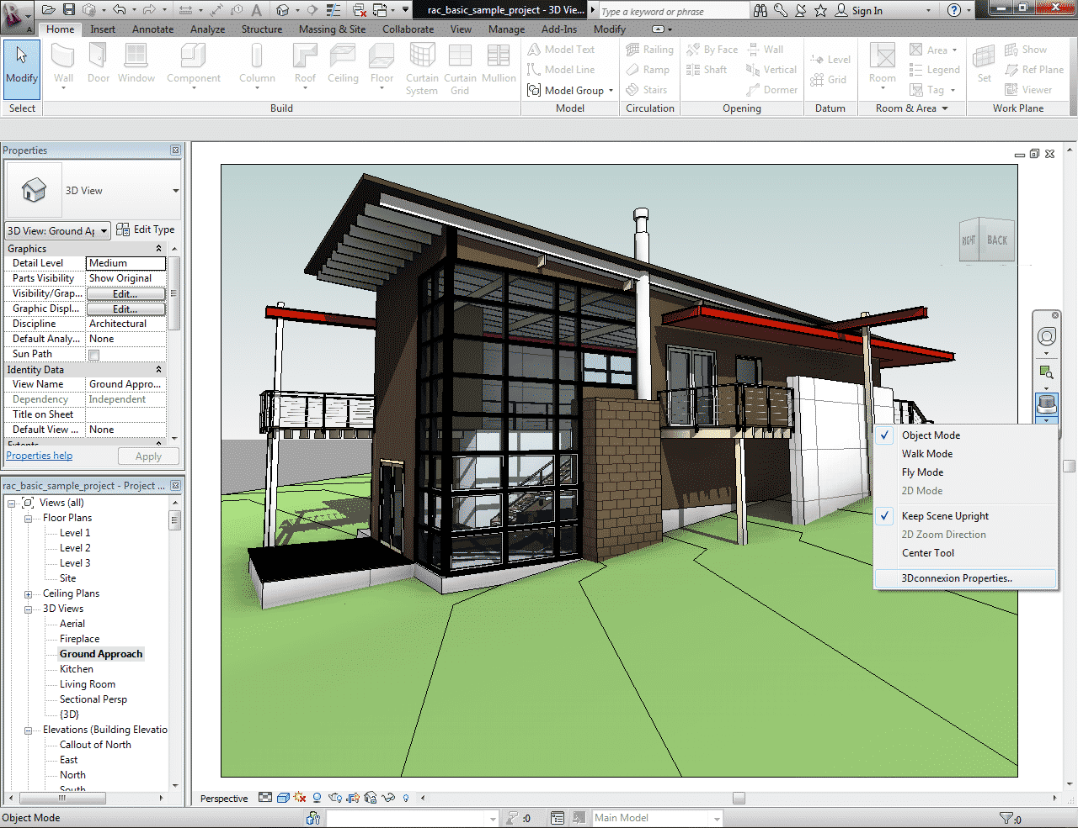
3
Building Information Modelling (BIM)
Notes:
3

Slide 4
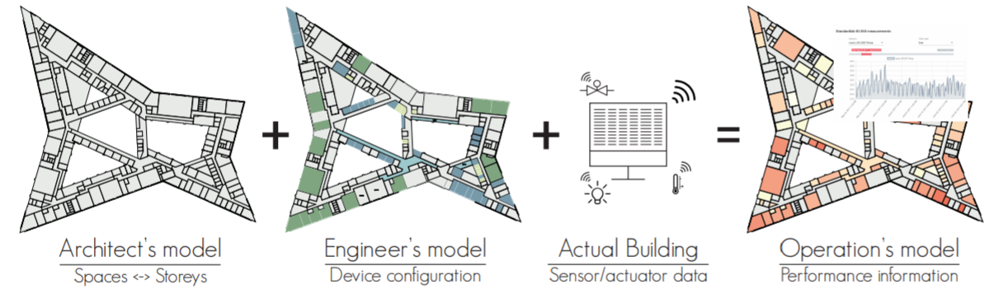
4
Building Life Cycle
Vast amounts of heterogeneous data produced during the life cycle of a building:
product data (building elements)
sensor measurements data
usage data
intelligent domotic system data
geographical data, weather data, ...
Notes:
4

Slide 5
industrial point of view
5
The Linked Data and Knowledge Graph technologies create opportunities for the industry:
indoor navigation
energy efficiency simulation
web-based facility management
and many more (cf. prop-tech)

Slide 6
WHAT IS OUR MISSION
Bring together experts in the area of Building Information Modeling (BIM), who are working to address the challenge of managing the huge amount of data that is generated across the building life cycle.
We want to provide a forum for bringing together researchers and practitioners who are working on advancing the field.

Slide 7
7
https://www.w3.org/DesignIssues/LinkedData.html
adapted to building data
Using URIs as names for building-related things such as: rooms, walls, products, elements, enable different parties to provide complementary descriptions of the same uniquely identified entities in different knowledge graphs.
Using HTTP URIs for these things enables the authority responsible for these URIs to provide reference information about this entity when one looks it up on the Web. For example, products in a catalogue, building appliances, or even the building itself.
Providing information using common standards (RDF, SPARQL) and common Knowledge Graph models enable semantic interoperability between data sources.
Include links to other URIs can help to discover more things, such as a link to the catalogue an appliance has been chosen from, or a link to the Web of Things Servient that enables it to interact with this appliance.

Slide 8
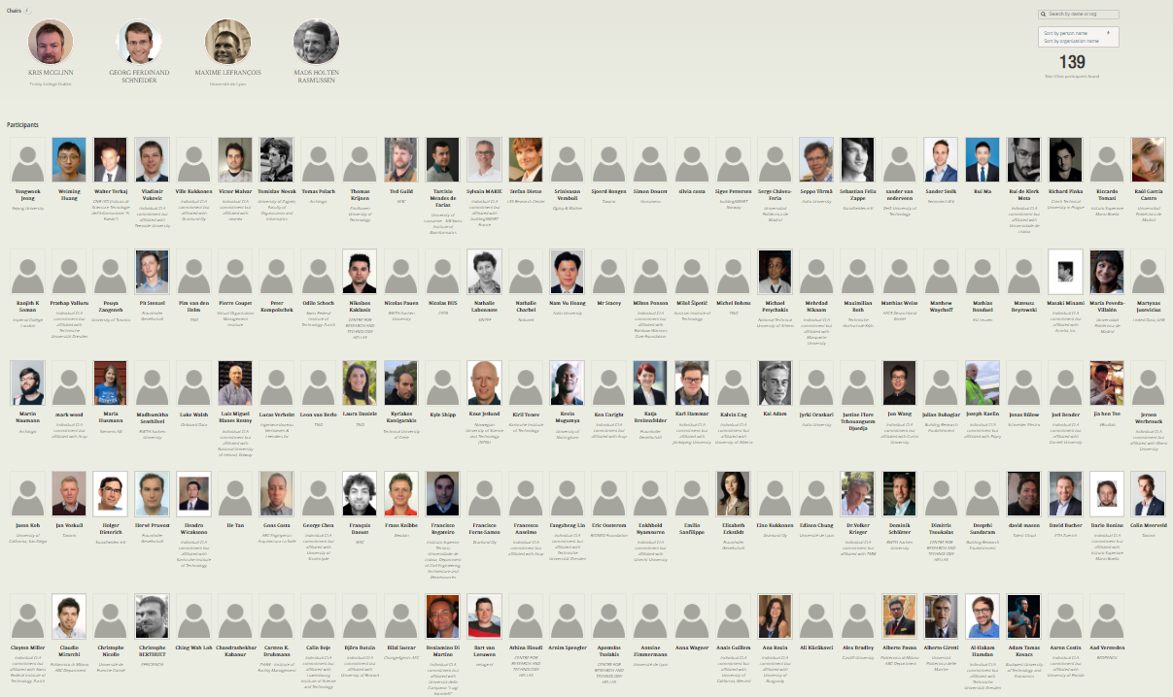
Who we are (2020)
started Dec. 2014 now 143 participants 18th biggest W3C CG
8
Notes:
8

Slide 9
How we work
9
W3C entrypoint: https://www.w3.org/community/lbd/
Group entrypoint: https://w3c-lbd-cg.github.io/lbd
On GitHub https://github.com/w3c-lbd-cg
Public mailing list
Regular online calls (every 2 weeks), minutes public, joint note-taking
Laisons with other groups and initiatives : BuildingSMART, ETSI SmartM2M, OGC, AFNOR, CEN, ISO, RealEstateCore, AIOTI WG3, ASHRAE 223 Semantic Interoperability, Brick Schema, AACE International, German expert groups "BIM und Holzbau" ("BIM and wood") and "Stahlbauforum" ("Steel construction")
Notes:
9

Slide 10
10
Links to existing Standardisation Groups
ISO TC59 SC13 : ISO 21597 Information Container for Data Drop (Parts 1&2), ISO 23262 GIS and BIM interoperability (TR)
ISO TC184 SC4 : WG12 T1 « Geometry Topology Ontology Feasibility »
buildingSmart Data Dictionary (bSDD)
Linked Data Working Group (LDWG)
French national plan for buildings’ digital transition
PPBIM : Dictionary of properties, Infrastructure, Processes
IDMI : Geometry Ontology
CEN TC 442 Building Information Modelling – WG4 Support Data Dictionaries “Semantic Modeling & Linking Guide”
CEN TC 205 WG19 Reference Ontology for Smart Appliances (CENELEC)
ETSI SmartM2M SAREF (Smart Applications Reference ontology) https://saref.etsi.org/
ASHRAE 135/223P BACnet Semantic Interoperability Working Group https://www.ashrae.org/technical-resources/standards-and-guidelines/titles-purposes-and-scopes#223P
Notes:
four of the main developers of SAREF are members of LBD-CG
10

Slide 11
11
Possible links to other W3C groups
W3C
Interest Groups
Working Groups
Community Groups
Dataset Exchange
Web of Things
Spatial Data on the Web
Automotive
(V2Building?)
Data Exchange
Web of Things
Schema.org
Blockchain
Automotive ontology
Notes:
https://www.w3.org/2017/12/odi-study/#rdf
CSVW - https://www.w3.org/community/csvw/
Devices and Sensors WG
https://www.w3.org/das/roadmap
Web of Things
WoT & OGC Sensorthings API
JSON-LD
Spatial Data on the Web IG
CityJSON
CovJSON
SSN extensions
SSN / SOSA
Web of Things IG
11

Slide 12
WHAT WE PRODUCE
Some of us push their work in the group

Slide 13
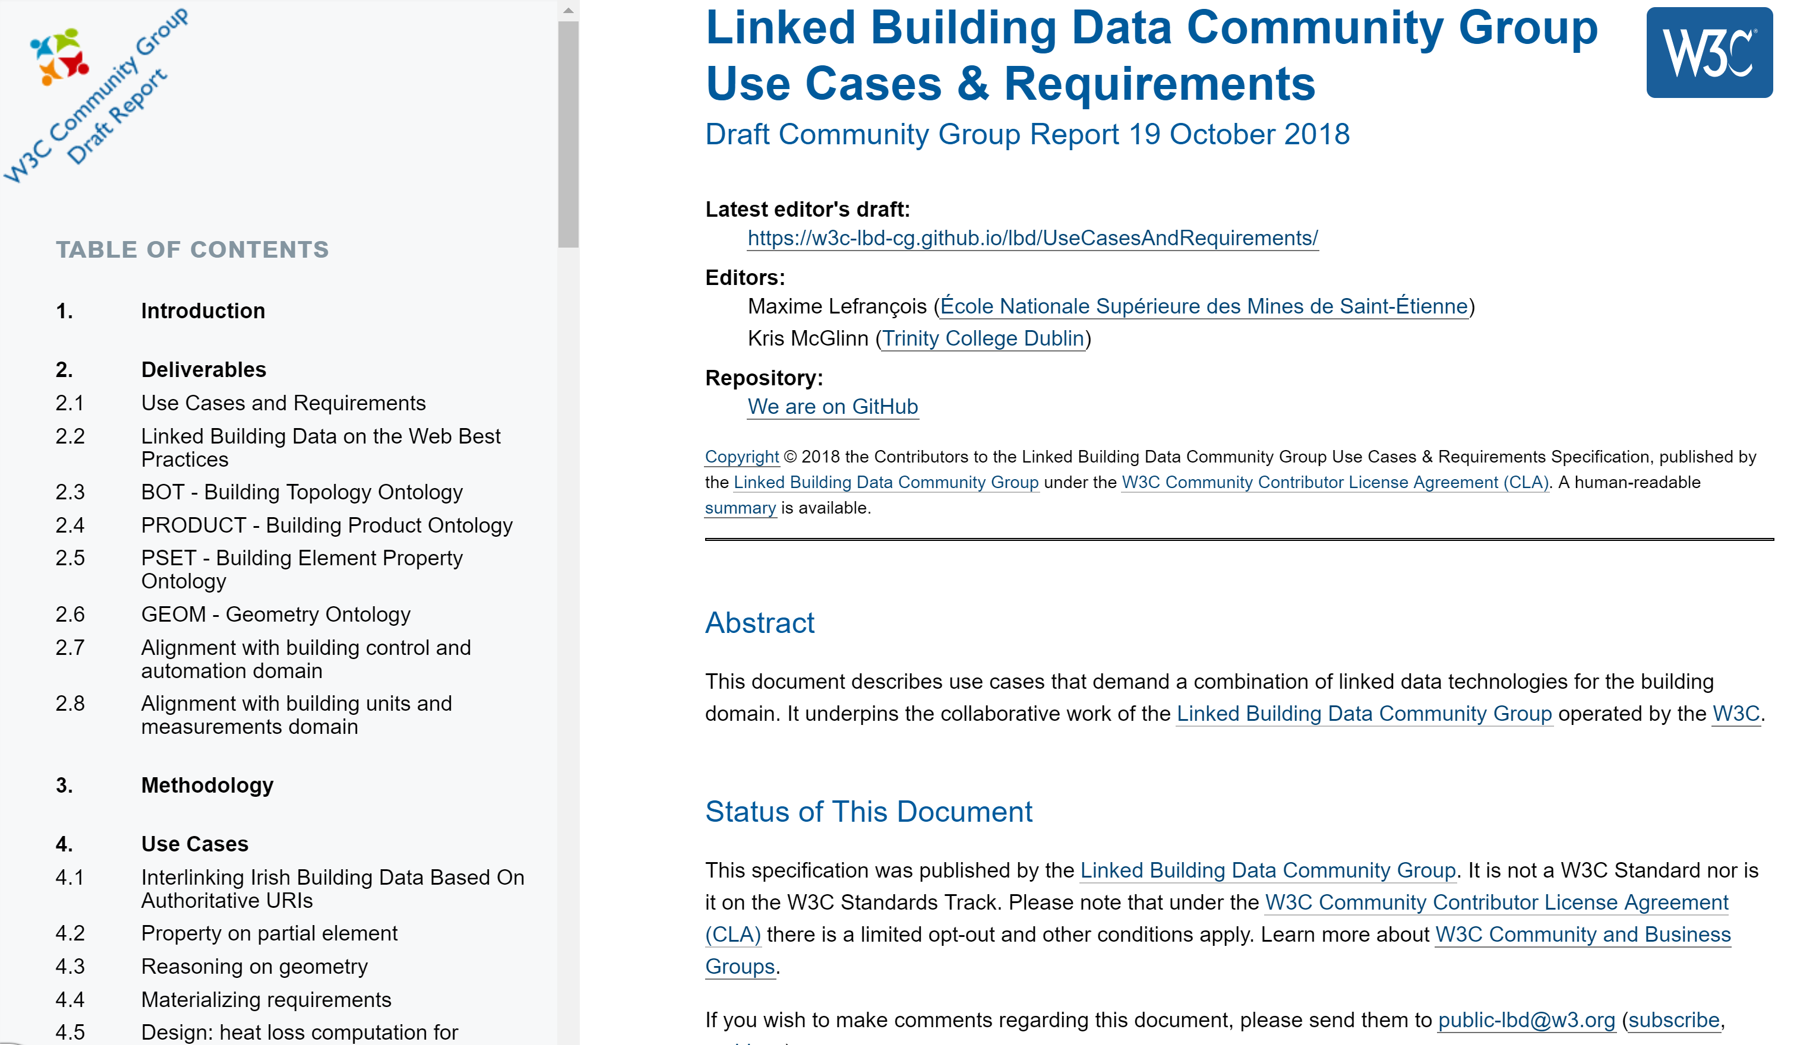
13
overview of the structure of the document
(at https://w3c-lbd-cg.github.io/lbd/UseCasesAndRequirements/ )
Comprehensive use case gathering is conducted across the LBD community, and also wider research and industrial communities (as part of the h2020 SWIMing project)
Used to identify deliverables and their scope in the charter
Currently 54 use cases, 7 requirements

Slide 14
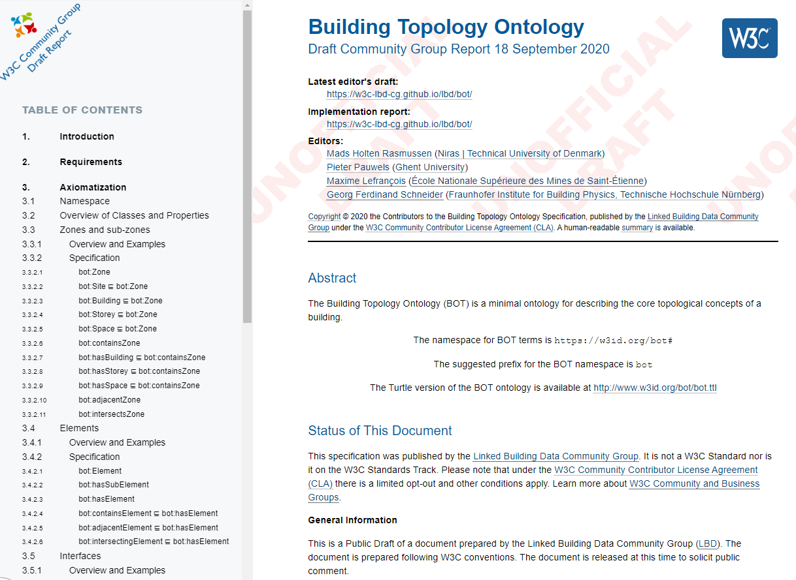
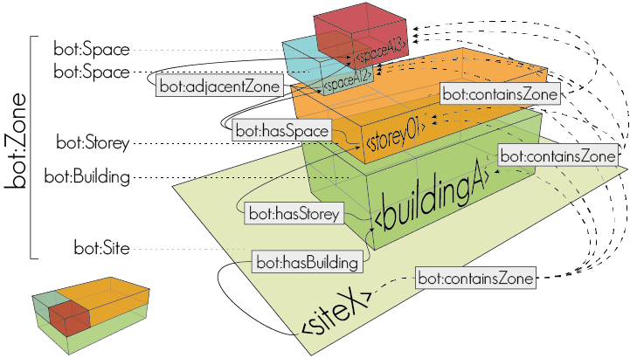
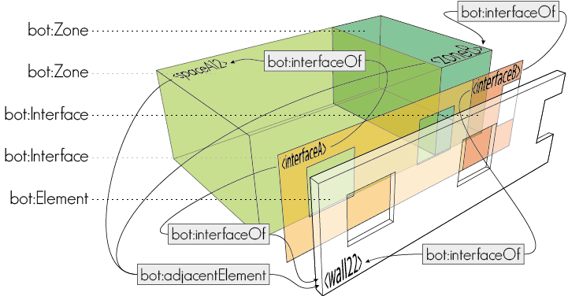
BOT (BUILDING TOPOLOGY ONTOLOGY)
14
overview of the structure of the document (at https://w3id.org/bot/ )
Mads Holten Rasmussen, Maxime Lefrançois, Georg Ferdinand Schneider, Pieter Pauwels (2020). BOT: the Building Topology Ontology of the W3C Linked Building Data Group, Semantic Web Journal, IOS Press

Slide 15
BOT (BUILDING TOPOLOGY ONTOLOGY)
15
Outgoing links
Incoming links
BOT Resource URI | Predicate | Aligned Resource URI
bot:Zone | rdfs:subClassOf | brick:Location
bot:Zone | rdfs:subClassOf | dogont:Environement
“The Building Topology Ontology (BOT) is a simple ontology defining the core concepts of a building.”
Aligned Resource URI | Predicate | BOT Resource URI
brick:Building, dogont:Building, dogont:Flat, ifc:IfcBuilding, rooms:Building, saref4bldg:Building | rdfs:subClassOf | bot:Building
brick:Equipment, brick:Point, dogont:Controllable, dogont:Device, dogont:UnControllable, dogont:TechnicalSystem ifc:IfcElement, rooms:Desk, saref4bldg:PhysicalObject, saref4bldg:Sensor, saref4bldg:Actuator, | rdfs:subClassOf | bot:Element
ifc:IfcSite, rooms:Site | rdfs:subClassOf | bot:Site
brick:Basement, brick:Outside, brick:Room, brick:Space, brick:Wing, brick:Zone, dogont:Room, ifc:IfcSpace, rooms:Room, saref4bldg:BuildingSpace | rdfs:subClassOf | bot:Space
brick:Floor, dogont:Storey, ifc:BuildingStorey, rooms:Floor, rooms:FloorSection | rdfs:subClassOf | bot:Storey
dogont:BuildingEnvironement | rdfs:subClassOf | bot:Zone
brick:contains, saref4bldg:contains | rdfs:subPropertyOf | bot:containsElement
dogont:hasWallOpening | rdfs:subPropertyOf | bot:hosts
rooms:contains, saref4bldg:hasSpace | rdfs:subPropertyOf | bot:containsZone
bot: https://w3id.org/bot#
brick: https://brickschema.org/schema/1.0.2/Brick#
dogont: http://elite.polito.it/ontologies/dogont.owl#
ifc: http://www.buildingsmart-tech.org/ifcOWL/IFC4_ADD2#
rdfs: http://www.w3.org/2000/01/rdf-schema#
rooms: http://vocab.deri.ie/rooms#
saref4bldg: https://saref.etsi.org/saref4bldg/
Notes:
15

Slide 16
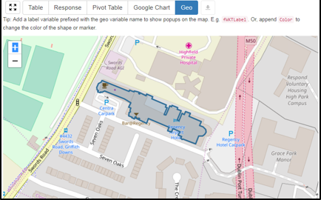
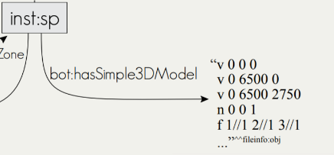
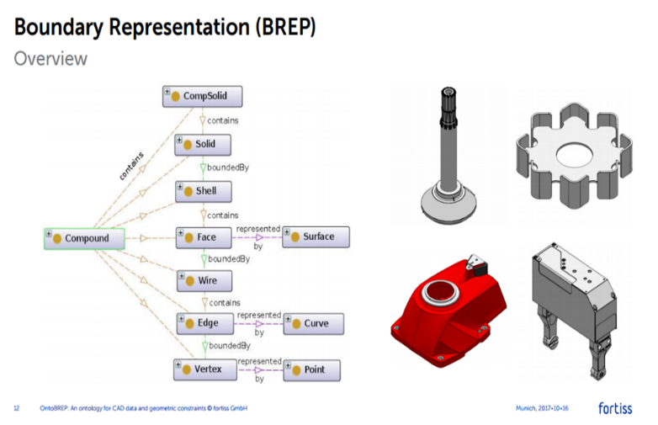
BOT (BUILDING TOPOLOGY ONTOLOGY)
16
Simple geolocation
bot:hasZeroPoint links to wsg84:Point
2D geospatial data
bot:Building is a subclass of geo:Feature, and can have geometry, which can be expressed as GeoSPARQL WKT.
3D geometry
bot:hasSimple3DModel links to a literal that encodes 3D geometry (e.g., OBJ model) bot:has3DModel links to a resource that further describes the 3D geometry with another vocabulary (e.g., the Geom ontology - http://rdf.bg/geometry.ttl )

Slide 17
Some Implementations and Tools
What our community members built

Slide 18
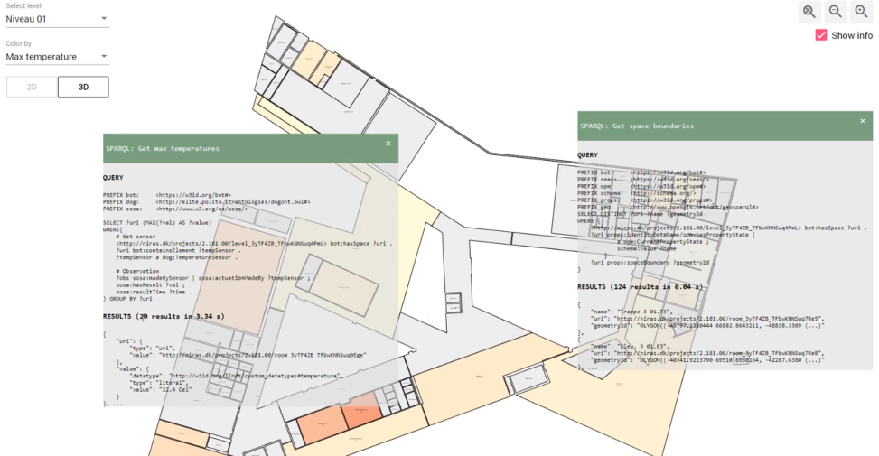
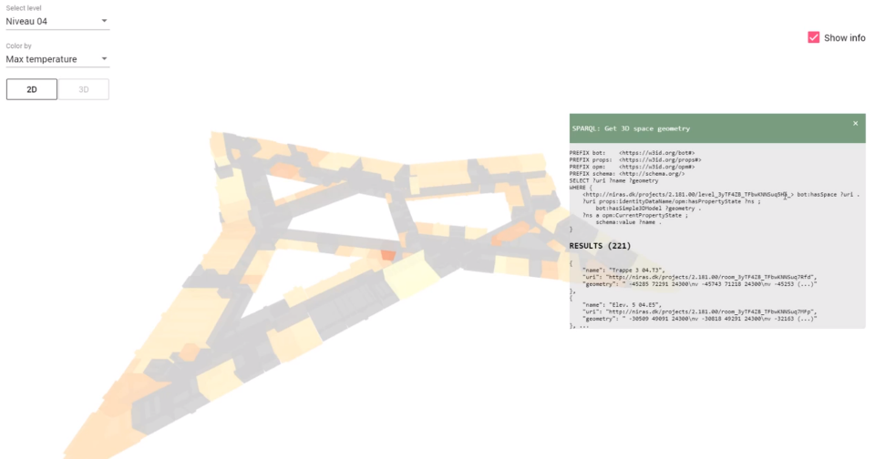
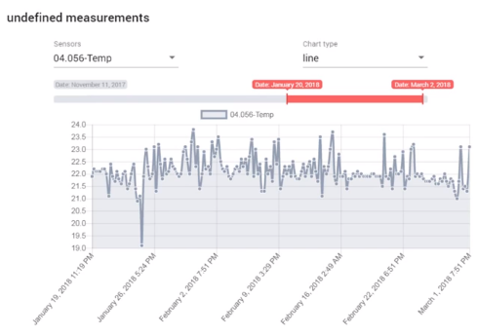
BOT + SOSA + geometry
18
https://youtu.be/P_38gIvrbmg

Slide 19
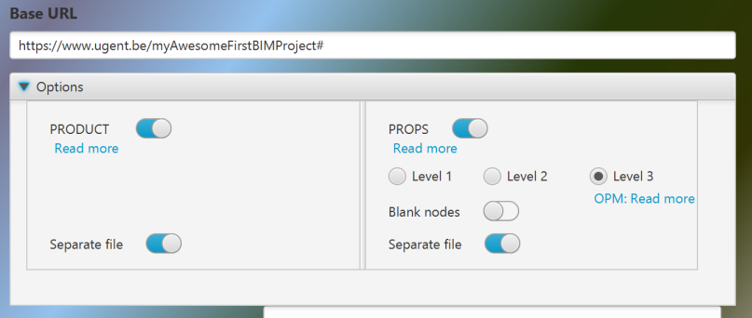
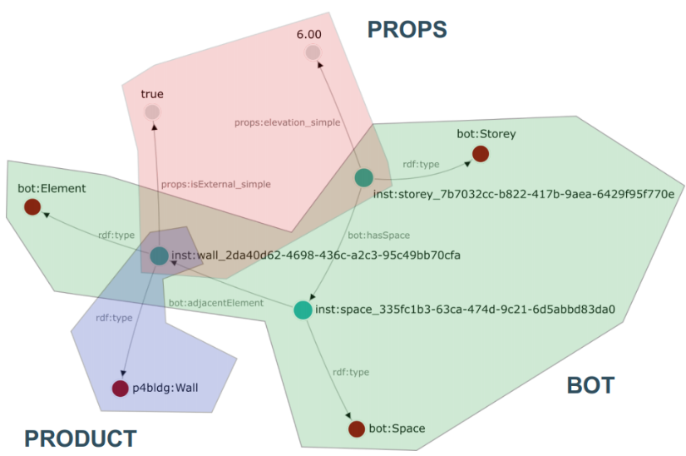
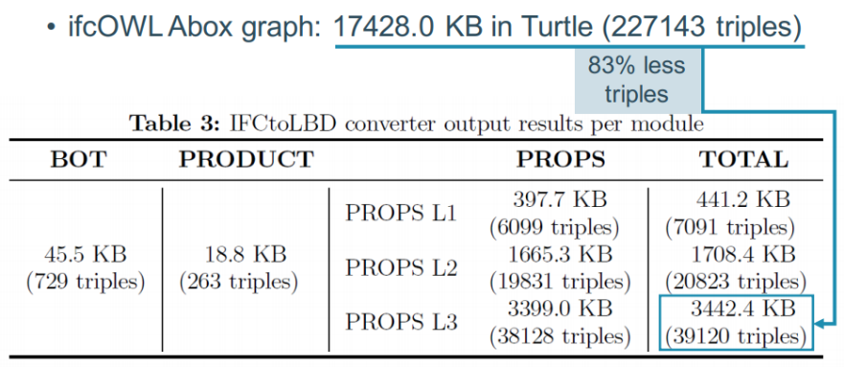
IFCtoLBD converter
19
https://github.com/jyrkioraskari/IFCtoLBD

Slide 20
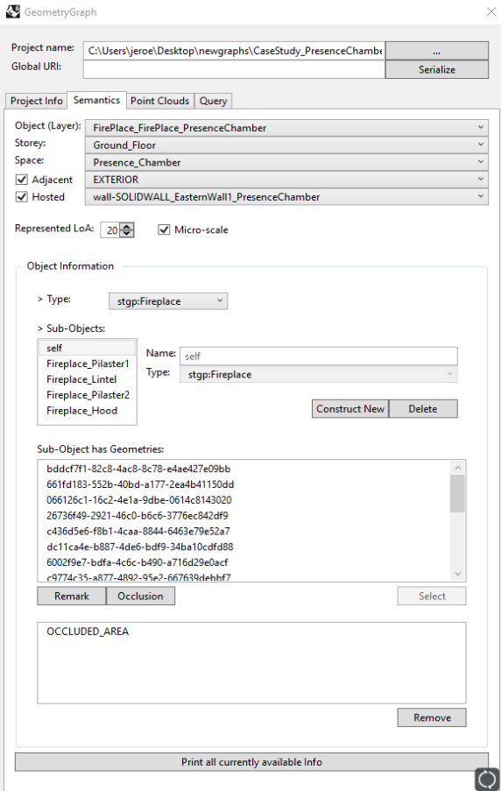
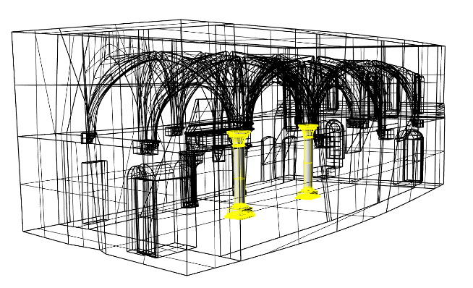
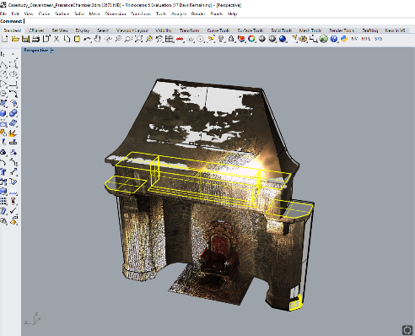
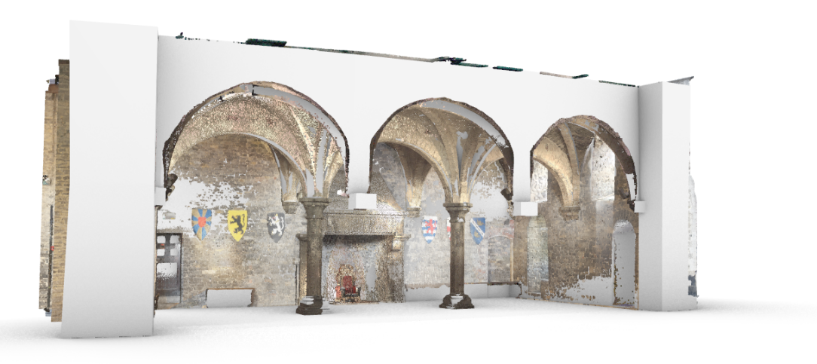
Scan to LBD Graph
20

Slide 21
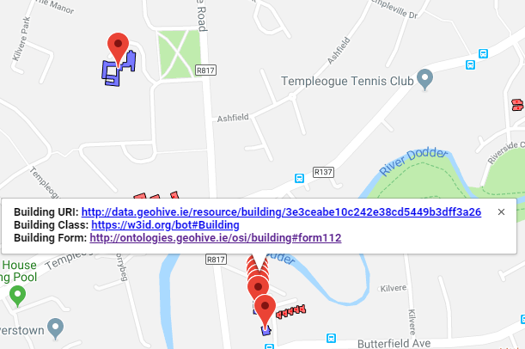
BOT with Added Geospatial
21
Using BOT to interlink Ordinace Survey Ireland building data (>3.5 million buildings)
Provide a registry of authoratative URI’s for Irish building stock.
http://geovis.adaptcentre.ie/
Username: odef_adapt
Password: geo123
https://www.scss.tcd.ie/~mcglink/video/tutorial/geovis/geovis.html

Slide 22
WHERE WE ARE HEADING AT?
Community as a platform and forum to gather experts and interested persons
→ Spin-off working group ? Pushing items to existing groups ?

Slide 23
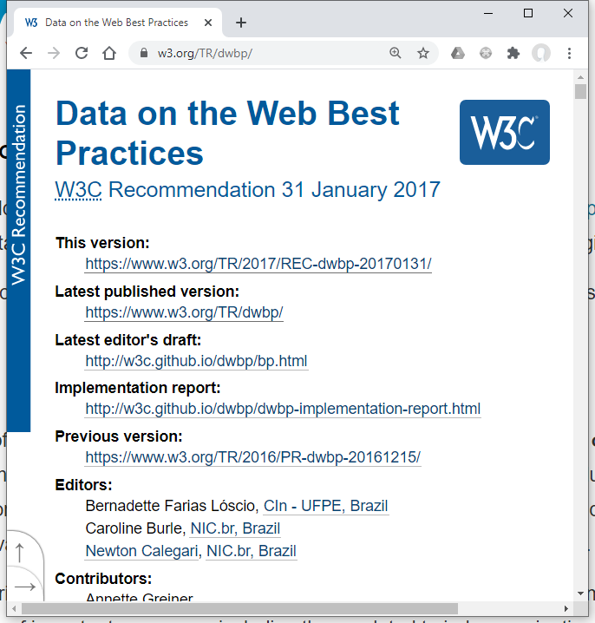
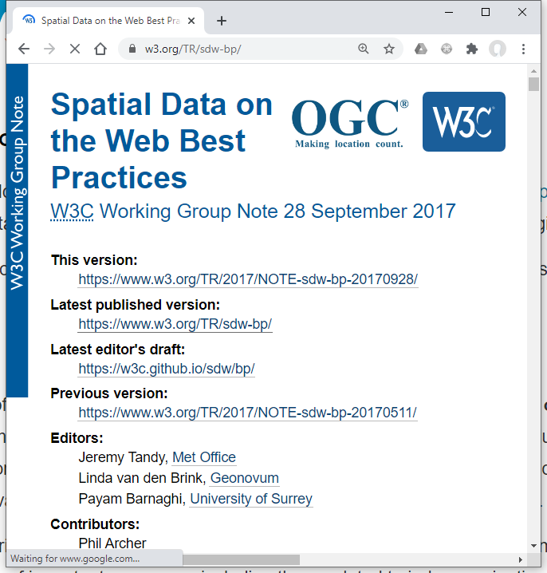
Building Data on the Web Best Practices ?
23
… (?)
Notes:
23

